Slide 1
Incremental Singular Value Decomposition Algorithms for Highly Scalable Recommender Systems (Sarwar et al)
Presented by Sameer Saproo

Slide 2
Recommender Systems
Apply Knowledge Discovery in Databases (KDD) to make personalized product recommendations during live customer interaction
Offline Vs Online
Not Google!

Slide 3
CF-based Recommender systems
Suggest new products or suggest utility of a certain product for a particular customer, based on customer’s previous liking and the opinions of other like-minded customers
 | Matrix | Pi | AI
Alice | 5 | 3 | x
Bob | x | 3 | 5
Carol | 5 | x | x

Slide 4
Challenges
Quality of Recommendation (Q)
Scalability of CF Algorithms (S)
SVD based Latent Semantic Indexing presents an approach to CF based recommendations, but stumbles in Scalability
The paper produces an algorithm for improving scalability for SVD based CF by sacrificing accuracy a little.

Slide 5
In Nutshell
Problem
The matrix factorization step in SVD is computationally very expensive
Solution
Have a small pre-computed SVD model, and build upon this model incrementally using inexpensive techniques

Slide 6
Singular Value decomposition
Matrix factorization technique for producing low-rank approximations
←n →
←m →
←n →
↑ n ↓
←n →
↑ m ↓
↑ m ↓
↑ m ↓
=
_{V}
_{A}
_{U}
_{S}

Slide 7
Low Rank Approximation (USV^{T})
U and V are orthogonal matrices and S is a diagonal matrix
S has r non-zero entries for a rank r matrix A.
Diagonal Entries (S₁, S₂, S₃, S₄,…, S_{r}) have the property that S₁ ≥ S₂ ≥ S₃ ≥ S ≥ … ≥ S_{r}
SVD provides best low-rank linear approximation of the original matrix A i.e. if

Slide 8
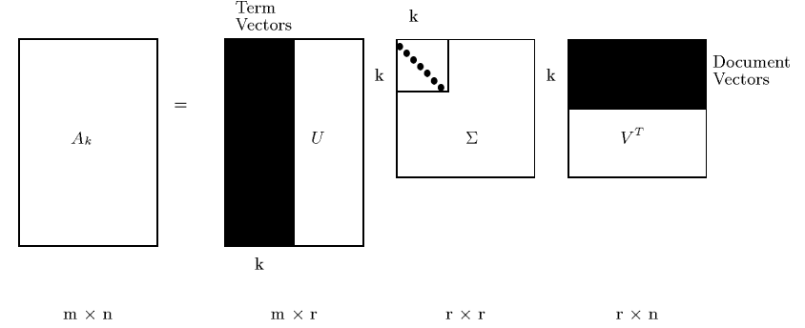
Contd.
A low-rank approximation of the original space is better than the original space as small singular values which introduce noise in customer-product matrix are filtered out.
SVD produces uncorrelated eigenvectors, and each customer/product is represented by its own eigenvector.
This dimensionality reduction helps customers with similar taste to be mapped into space represented by same eigenvectors.

Slide 9
Prediction Generation
Formally,

Slide 10
Challenges of Dimentionality reduction
Offline Step
Also known as Model Building
User-user similarity computation and neighborhood formation i.e. SVD decomposition
Time consuming and infrequent
O(m³) for m x n matrix A
Online Step
Also known as Execution step
Actual prediction generation
O(1)

Slide 11
Incremental SVD Algorithms
Borrowed from the LSI world to handle dynamic databases
Projection of additional users provides good approximation to the complete model
Authors build a suitably sized model first and then use projections to incrementally build on that
Errors induced as the space is not orthogonal

Slide 12
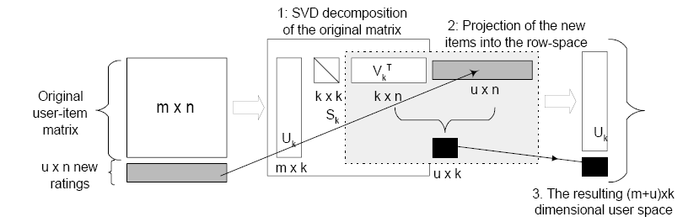
Folding-In
As depicted in the paper
Found in Reference [1]

Slide 13
Experimental Evaluation
Dataset : www.movielens.umn.edu
About 100,000 ratings
User – Movie matrix : 943 users and 1682 movies
Training – Test ratio : 80%
Evaluation Metric
Mean Absolute Error (MAE) =
is a ratings – prediction pair

Slide 14
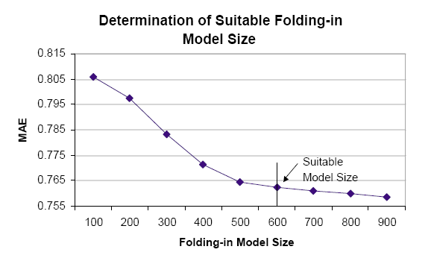
Model Size
Optimal reduced Rank k=14 was found empirically
(943 – Model size) is projected using folding-in

Slide 15
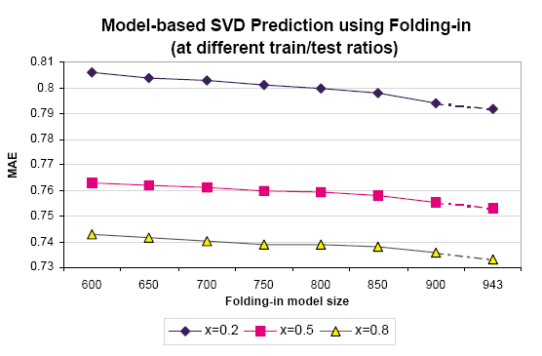
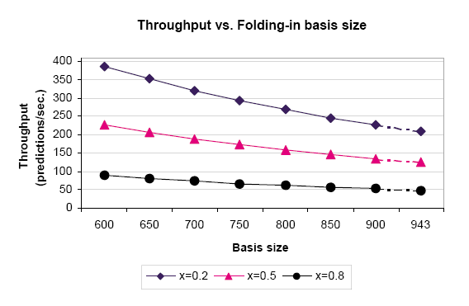
Results
Quality
Performance
For Model size of 600, quality loss was 1.22% whereas performance increase was 81.63%

Slide 16


